Slide 1
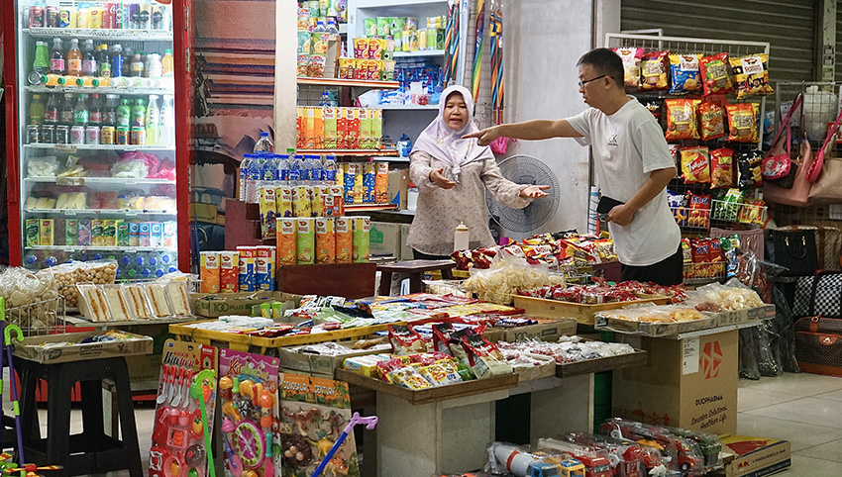



Z phier
A financial passport for MSMEs

Slide 2



MSMEs often lack access to timely and accurate financial insights, making it difficult for them to secure loans or financial assistance …
290 bil
MSMEs funding gap reported by The Securities Malaysian Commision
(Source: The Star)
87%
of SMEs encounter difficulties securing financing
37%
struggle with complicated application process
29%
not able to qualify for loan
(Source: Capbay)

Slide 3



Z phier
Introducing Z phier, an AI passport tool to help MSMEs like Kak Zariah Bakery
Wanted to ….
Apply for a small grant or microloan
Track income and expenses to scale sustainably
But ….
Overwhelmed by the forms & requirements
No accounting knowledge & credit history
Kak Zariah
Women entrepreneur
Kak Zariah Bakery
1
Budget planning
2
Loan eligibility assessment
3
Financial health monitoring

Slide 4



Utilizing Alibaba ecosystem for reliable and scalable development…
ApsaraDB RDS
LLM Model (qwen-plus)
MySQL Database
Data Visualization

Slide 5
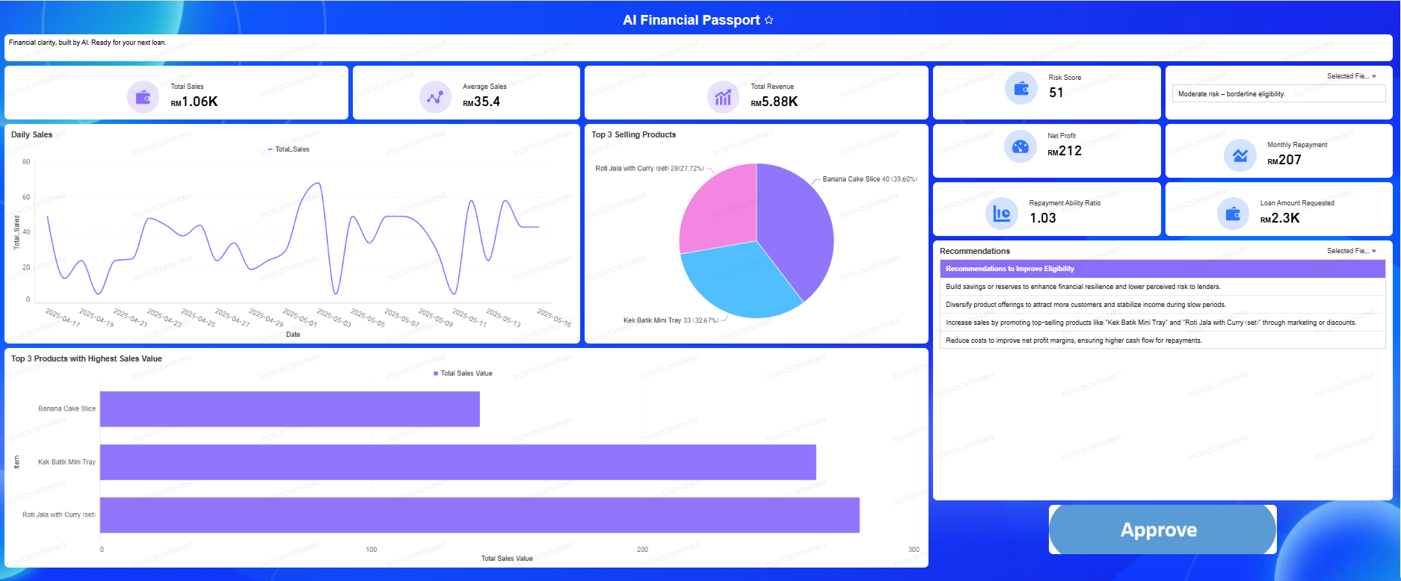
Dashboard
Rule based calculation based on Microfinance Institutions (MFIs)
Business data
LLM analysis

Slide 6
References
Capbay: https://capbay.com/shift-the-focus-prioritise-factors-within-your-control-when-seeking-sme-financing/?utm_source=chatgpt.com
The Star
https://www.thestar.com.my/business/business-news/2024/05/27/sme-funding-puzzle?utm_source=chatgpt.com
Basic Financial Management and Ratio Analysis for MFIs Toolkit
https://www.findevgateway.org/sites/default/files/publications/files/mfg-en-toolkit-basic-financial-management-and-ratio-analysis-for-mfis-toolkit-mar-2008_0.pdf?utm_source=chatgpt.com

Slide 7

Thank You
With Zaphier, MSMEs could have better chance of showcasing their business strength

